Slide 1

Customer Complaints
Email Classification
Case Study | ML Engineer
Luis Rodrigues
luis-rodrigues-phd
Notes:
I’m going to start with a short presentation to introduce myself, the case study and the solution.

Slide 2

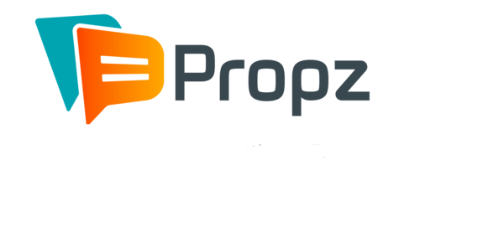










































PROFESSIONAL TRAJECTORY OF LUIS RODRIGUES
COURSEWARE EDITOR
EDUCATIONAL ADVISOR
ADJUNCT
PROFESSOR
ONLINE
TUTOR
RESEARCHER IN
SYSTEM CONTROL
DATA SCIENTIST
+ DS MANAGER
LEAD DATA SCIENTIST
PRINCIPAL DATA CONSULTANT
PROFISSIONAL
EXPERIENCE
2005
2009
2012
SKILLS
2008
2010
2011
2014
2016
2018
2020
2022
ACADEMIC EDUCATION
BACHELOR’S DEGREE
MATHEMATICS
MASTER’S DEGREE
MECHANICAL ENG.
DOCTORATE
MECHANICAL ENG.
PROJECT
EVOLUTION
MARKETING/CRM PROJECT
EDA, Customer Segmentation, KPI
AI PROJECT
Big Data, Recommender Systems
INNOVATION PROJECT
A/B Testing, Data Analysis
INNOVATION PROJECT
NLP, A/B Testing, OKR
AI PROJECT
Recommender Systems
AI PROJECT
NLP, LLM, (Near) Real-Time Predictions
Notes:
First things first, who am I?
I’ve being working in the data science field since 2016.
I started working as a researcher at I.Systems, industrial sistem control company.
So, in 2018, I got my first job as a Data Scientist at Propz, a marketing e CRM company.There, I also served as Data Science Manager.
After that, in 2020, I acted as a Lead Data Scientist at CI&T, a digital transformation company.
Finany, in 2022, I’ve moved to Portugal to work as a Principal Data Consultant at Aubay in a project to develop a NLP platform for Banco de Portugal.
Now, I believe that the role as a Machine Learning Engineering at Crayon is the best next action for my career.
Why? Well, why Crayon is a question to answer usually only for Mariana. However, why ML Engineer is import to answer for all of you.
I’m aware of the importance of the machine learning engineering since 2019, when I deployed a recommender system for Carrefour, one of largest retailers in Brazil and, I guess, in the world. The model should run daily for 20 million customers. I’m talking about more than 10 billion transactions every single day. I was hard to deliver it.
After that, at CI&T, I had the opportunity to develop a recommender system for Nestlé, the largest CPG in the world. As my final contribution, applied mlflow and azure data factory to implement the best MLOps practices. Specifically, I used mlflow to manage all the metadata from the model runs - data version, parameters, execution times, results and models, using model store from mlflow.
Finally, at Aubay, I’m working with near real time predictions, where our tech stack involves fastapi, docker and kubernetes.
So, what I’ll show you today is a mixture of all these in a simple version.
But, before talking about the solutions, let’s review our case study.

Slide 3
01
CASE STUDY

Slide 4





CASE STUDY | CUSTOMER COMPLAINTS EMAIL CLASSIFICATION
Customer Complaint
Email
Inbox
Robotic Process Automation
Complaint
Expert
Scope of the Case Study
ML Service for
Complaint Classification
Implement an ML inference pipeline and deploy a REST endpoint that consumes the trained ML model

Slide 5

CASE STUDY | CUSTOMER COMPLAINTS EMAIL CLASSIFICATION
About Dataset
Context
The Consumer Financial Protection Bureau (CFPB) is a federal U.S. agency that acts as a mediator when disputes arise between financial institutions and consumers. Via a web form, consumers can send the agency a narrative of their dispute. An NLP model would make the classification of complaints and their routing to the appropriate teams more efficient than manually tagged complaints.
Content
A data file was downloaded directly from the CFPB website for training and testing the model. It included one year's worth of data (March 2020 to March 2021). Later in the project, I used an API to download up-to-the-minute data to verify the model's performance.
Each submission was tagged with one of nine financial product classes. Because of similarities between certain classes as well some class imbalances, I consolidated them into five classes: credit reporting, debt collection, mortgages and loans (includes car loans, payday loans, student loans, etc.), credit cards, retail banking (includes checking/savings accounts, as well as money transfers, Venmo, etc.).
After data cleaning, the dataset consisted of around 162,400 consumer submissions containing narratives. The dataset was still imbalanced, with 56% in the credit reporting class, and the remainder roughly equally distributed (between 8% and 14%) among the remaining classes.
https://www.kaggle.com/datasets/shashwatwork/consume-complaints-dataset-fo-nlp

Slide 6
02
SOLUTION

Slide 7


SOLUTION ARCHITECTURE | PROPOSAL
Client
Microservice
Data Repository
Monitoring
(id, narrative)
Predict
(id, narrative)
Data & Model Drift
(category, probability)
(id, category, probability)
Narrative Dataset
Model Performance
(id, true label)
Feedback
(id, true label)
(success massage)
Categories Dataset
Model Training
Data Validation
Data Preparation
Original Dataset
Model Training
Model Repository
Model Evaluation
Model Validation
ML Metadata
ML Model

Slide 8







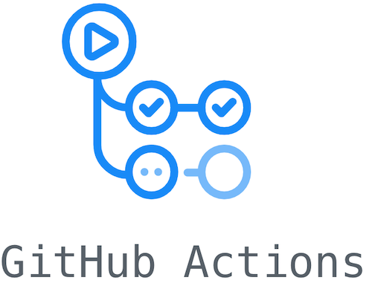
SOLUTION ARCHITECTURE | DEVELOPED
Client
Microservice
Data Repository
Monitoring
(id, narrative)
Predict
(id, narrative)
Data & Model Drift
(category, probability)
(id, category, probability)
Narrative Dataset
Model Performance
(id, true label)
Feedback
(id, true label)
(success massage)
Categories Dataset
Model Training
Data Validation
Data Preparation
Tech Stack
Original Dataset
Model Training
Model Repository
Model Evaluation
Model Validation
ML Metadata
ML Model

Slide 9

CI/CD/CT PIPELINE | PROPOSAL
Orchestrated Experiment
EDA
Source
Code
Code
Repository
Model Training Pipeline
REST API
ML
Ops
Data Repository
REST API
Packaging
Data, Code & Model
Testing
Model
Repository
Model Training Pipeline
CI
CD
Prediction
Service
Service
Monitoring
Trigger

Slide 10
CI/CD/CT PIPELINE | DEVELOPED
Orchestrated Experiment
EDA
Source
Code
Code
Repository
Model Training Pipeline
REST API
ML
Ops
Data Repository
REST API
Packaging
Data, Code & Model
Testing
Model
Repository
Model Training Pipeline
CI
CD
Prediction
Service
Service
Monitoring
Trigger

Slide 11
DEMONSTRATION
ML model prototype in notebook
Kedro architecture overview
Development setup
Productionized model training pipeline
Train a model and show logs and artifacts
Productionized model inference pipeline
Make a prediction and show logs
REST API to serve online predictions
Show the prediction service running locally
Show and run data, code and model tests
GitHub Actions workflow to check PRs
Create a PR to show the workflow running
GitHub Actions workflow for deployment
Merge the PR to show the workflow running
Dockerfile to package the prediction service
Train the model and serve prediction using the container

Slide 12
THANK YOU

